Slide 1
Series Inverter
Commutating Elements L & C are
connected in series with load.
Load current flows continuously
through L & C.
Hence, this circuit is used in
high frequency applications.
R

Slide 2

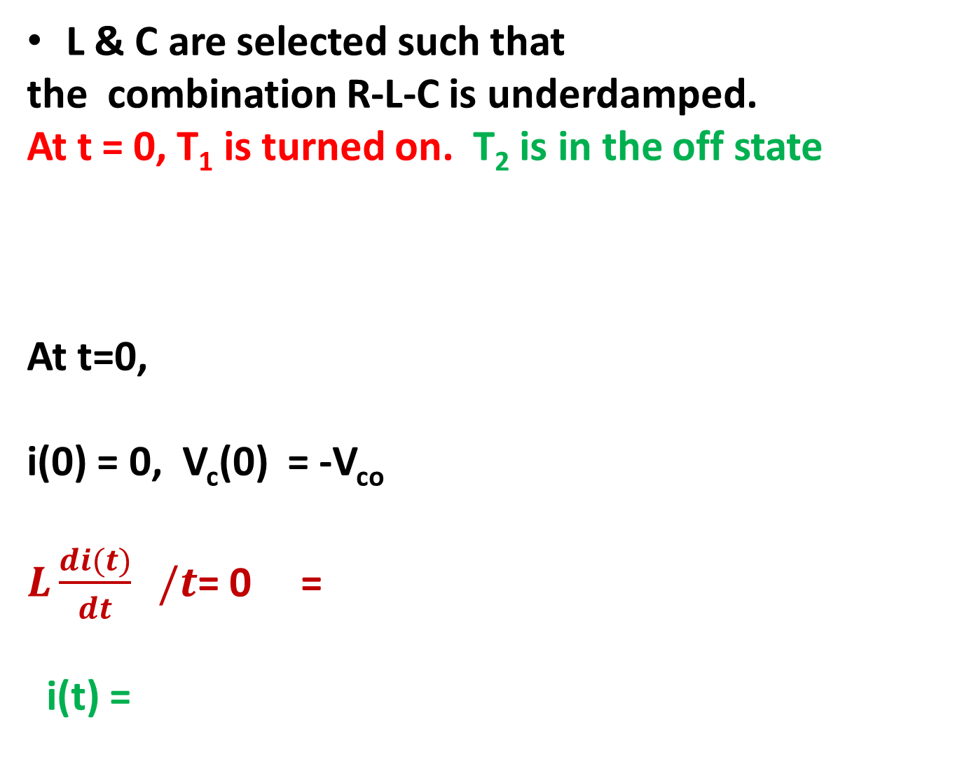
L & C are selected such that
the combination R-L-C is underdamped.
At t = 0, T₁ is turned on. T₂ is in the off state
At t=0,
i(0) = 0, V_{c}(0) = -V_{co}
$L\frac{di(t)}{dt} /t$= 0 =
i(t) =
R
$V_{d}+$ $V_{co}$

Slide 3
R

Slide 4
π / ωr < t < T/2
Both switches are off
i(t) = 0, i_{s}(t) = 0
V_{L}(t) = 0, V_{C} = V_{Cmax}
R

Slide 5
T/2 < t < T/2+ π / ωr
At t’ = 0, T₂ is turned on.
0 < t’ < T/2
At t’ =0
i(0) = 0, V_{c}(0) = V_{cmax}
t’ = t - T/2
R

Slide 6
Drawbacks of series inverter
Maximum inverter frequency is limited to a value less than the circuit ringing frequency.
For very low values of inverter frequencies, load voltage is highly distorted.

Slide 7
DESIGN of L
L is chosen on the basis of attenuation factor.
Peak value of i(t) is
If there is no attenuation, then i(t) would be
and peak value is
Attenuation factor
L is selected such that AF = 0.5

Slide 8
DESIGN of C
C is selected from the value of ω_{r}
If load is variable, then C is selected for the maximum possible value of R so that the circuit is under damped.
Voltage rating of C is V_{d} + V_{co}

Slide 9
Selection of Thyristor
Forward blocking voltage rating must be greater than V_{cmax}
Peak current rating must be greater than peak load current for minimum load resistance
t_{q} must be less than

Slide 10
Modified Series Inverter
L₁ = L₂
C₁ = C₂
L₁ and L₂ are tightly coupled
For t = 0_ T₂ is on
v _{c1} = v _{c max}
v _{c2} = - v _{c min}
i₀ is negative
v ₀ = i ₀ × R
i_{c1} is positive
i_{c2} is negative
i_{s} is positive
i₀
v_{L2} is negative
v_{L1} is negative

Slide 11
At t = 0, T₁ is turned on.
v_{c1} is coupled across L₁
= v_{L2}
T₂ is commutated off.
C₁ discharges through L₁ and load
V_{c1} changes from v_{c1max} to v_{c1min}
C₂ gets charged through T₁, L₁ and
load
i₀ = i_{s} – i_{c1}
i_{c2} = i_{c1} + i₀
i_{s} = i_{c2}
v_{L1} = v_{L2} is positive when di_{o}/dt is positive
i₀

Slide 12
At t = T/2, T₂ is turned on.
v_{c2} is coupled across L₂
= v_{L1}
T₁ is commutated off.
C₂ discharges through L₂ and load
V_{c1} changes from v_{c1min} to v_{c1max}
C₁ gets charged through load, T₂, and L₂
i₀ = i_{s} – i_{c2}
i_{s} = i_{c1}
V_{T1} = V_{d} - V_{L1} - V_{L2} = V_{d} - 2V_{L1}
i₀

Slide 13
Inverter frequency can be less than the ringing frequency.
During negative half cycle also source supplies power. Lesser distortion in source current.

